Slide 1



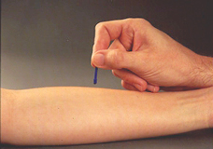
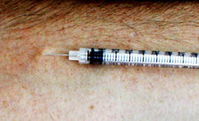
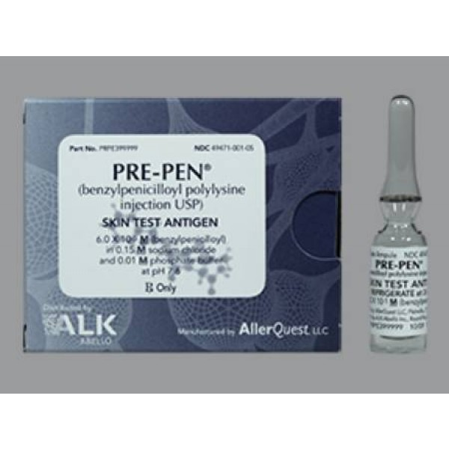
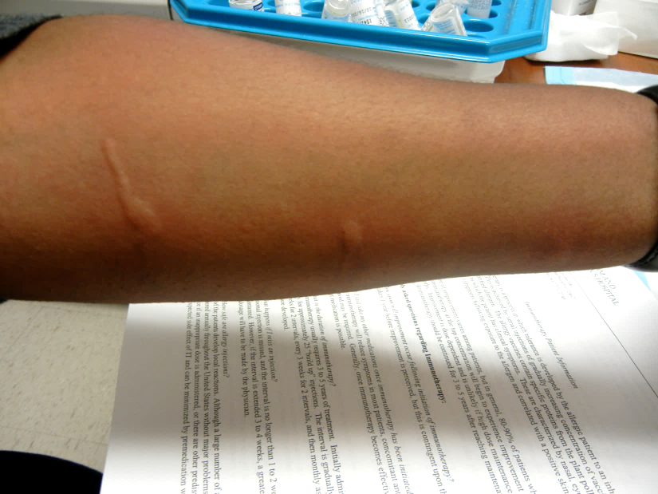
Pre-Operative Cardiothoracic Surgery
Penicillin Allergy Evaluation
Kimberly G. Blumenthal, MD, MSc^{1,2,6};Laura Collier, MS, RN³; Yu Li, MS¹; Erin E. Ryan, MPH, CCRP^{4,5}; Serguei Melnitchouk, MD, MPH^{3,6}; Thoralf M. Sundt, MD^{3,6}; Elbert Heng⁷; Erica Shenoy, MD, PhD^{4,5,6}
¹Division of Rheumatology, Allergy and Immunology ²Edward P. Lawrence Center for Quality and Safety ³Department of Surgery ⁴Infection Control Unit ⁵Division of Infectious Diseases, Massachusetts General Hospital, Boston ⁶Harvard Medical School, Boston ⁷The Warren Alpert Medical School of Brown University, Providence.
INTRODUCTION
RESULTS
Surgical site infections (SSI) result in substantial morbidity and mortality; reducing SSIs is a national healthcare priority.
Cefazolin is the recommended perioperative antibiotic in cardiothoracic surgery; patients with a penicillin allergy receive less effective perioperative antibiotics and have an increased SSI risk.
Although penicillin allergy is reported by >10% of surgical patients, >95% of patients do not have a true penicillin allergy.
Of 59 cardiothoracic surgery patients referred, 48 (81%) were assessed by Allergy and ultimately had surgery (Fig 2).
Penicillin allergies were most commonly cutaneous (e.g., hives, rash; Fig 3).
48 (100%) were not allergic; 47 (98%) received cefazolin.
Cefazolin use was significantly greater in patients evaluated by Allergy compared to those who were not (98% vs 14%, p<0.001).
There were no adverse or allergic reactions resulting from allergy testing or administration of cefazolin perioperatively.
PROJECT AIM
Fig 2. Outcomes of Cardiothoracic Surgery Patients Referred For Penicillin Skin Testing
To implement and assess a perioperative penicillin allergy evaluation program for outpatient cardiothoracic surgery patients at an academic tertiary care referral center.
59 Cardiothoracic Surgery patients referred to Allergy
7, Did not have Allergy appointment
2, Patient found inconvenient
2, Patient no showed
1, Allergy history warranted
penicillin avoidance
2, Unknown
PROJECT DESIGN
4, Did not have surgery
Patient Selection
Outpatients with cardiothoracic surgery recommended and a penicillin allergy history were referred to Allergy.
All patients, except those whose allergy histories warranted avoidance (e.g., history of a severe delayed immunologic reaction such as Stevens-Johnson syndrome or recent [<5 years ago] anaphylaxis) were booked for a visit.
Allergy Evaluation
Patients were advised to hold their beta-blockers for at least 6 hours and antihistamine medications for 5 days prior to their Allergy appointment.
After a history and physical exam, penicillin skin testing was performed using Pre-Pen® and dilutions of penicillin G (Fig 1).
If the skin tests were negative, amoxicillin 500 mg was given, followed by a 60 minute observation time.
Outcomes
General feasibility of this approach.
Frequency of negative penicillin allergy evaluations.
Frequency of use of cefazolin.
Adverse and allergic reactions.
48 patients evaluated by Allergy preoperatively
1 (14%) received cefazolin
0 patients tested positive
48 patients tested negative
1 (2%) patients did not receive cefazolin
47 (98%) received cefazolin
Fig 3. Penicillin Allergy Histories of Patients Referred For Penicillin Skin Testing
Fig 1. Penicillin Skin Testing
CONCLUSION
Penicillin allergy evaluation is a safe and effective way to improve perioperative antibiotic choice in cardiothoracic surgery patients.
NEXT STEPS
Photo courtesy of Paige Wickner, Brigham and Women’s Hospital
To evaluate the frequency of successful referral for cardiothoracic surgery patients with penicillin allergy.
To expand Allergy evaluation to other surgical disciplines.
To assess the impact of this approach on SSIs.

